Slide 1

Cryptography
Joseph Fulkerson

Slide 2
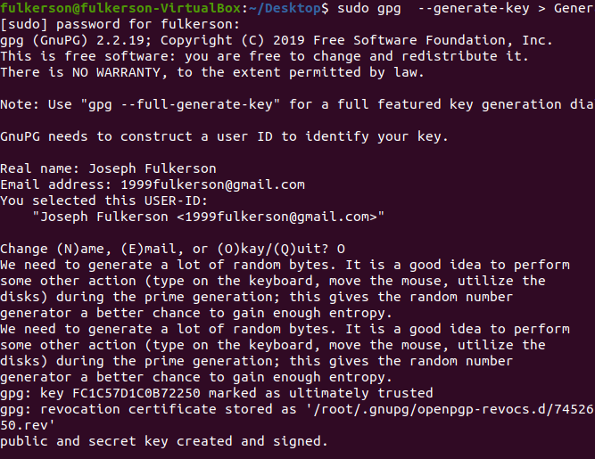
Gnupg
This is a hybrid encryption program that uses combinations of conventional symmetric-key cryptography and public-key cryptography.

Slide 3

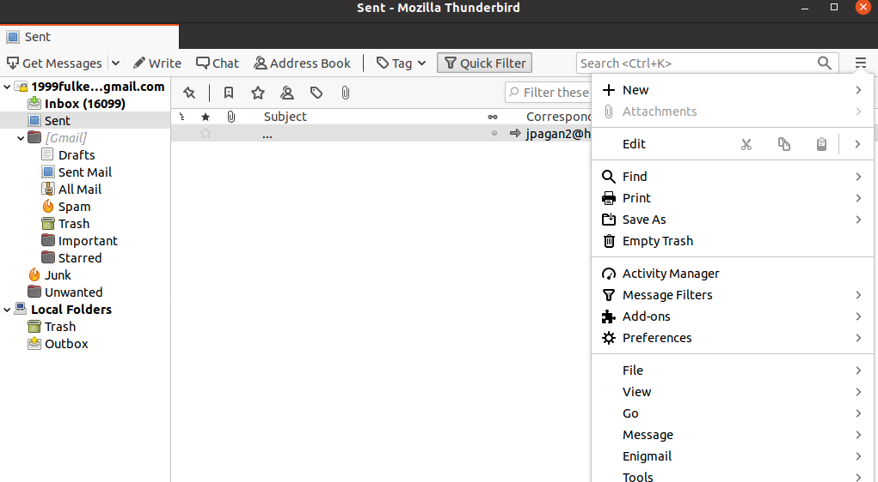
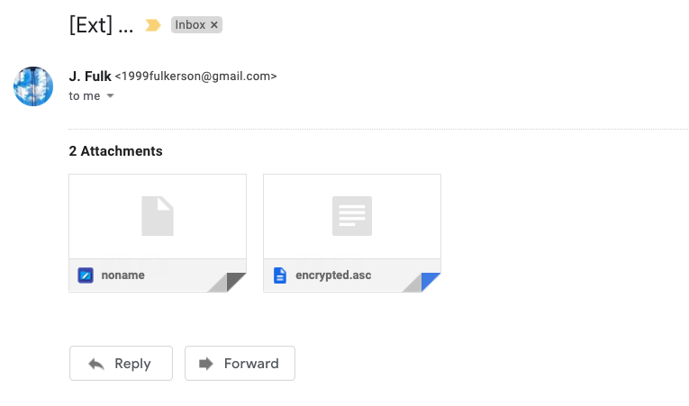
Encrypted Email
This is another way of sending an encrypted email utilizing thunderbird email and Enigmail encryption

Slide 4
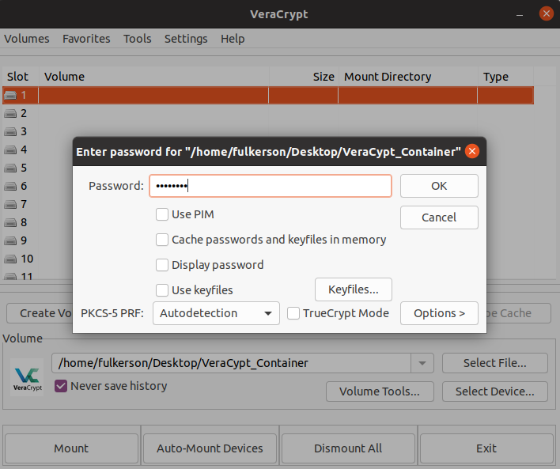
VeraCrypt
VeraCrypt is being used here to encrypt a containing folder of other files.

Slide 5
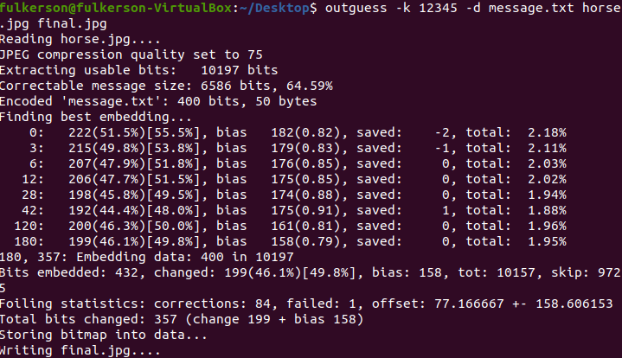

Stenography
This is an example of stenography where I used outguess to hide a message within a picture

Slide 6
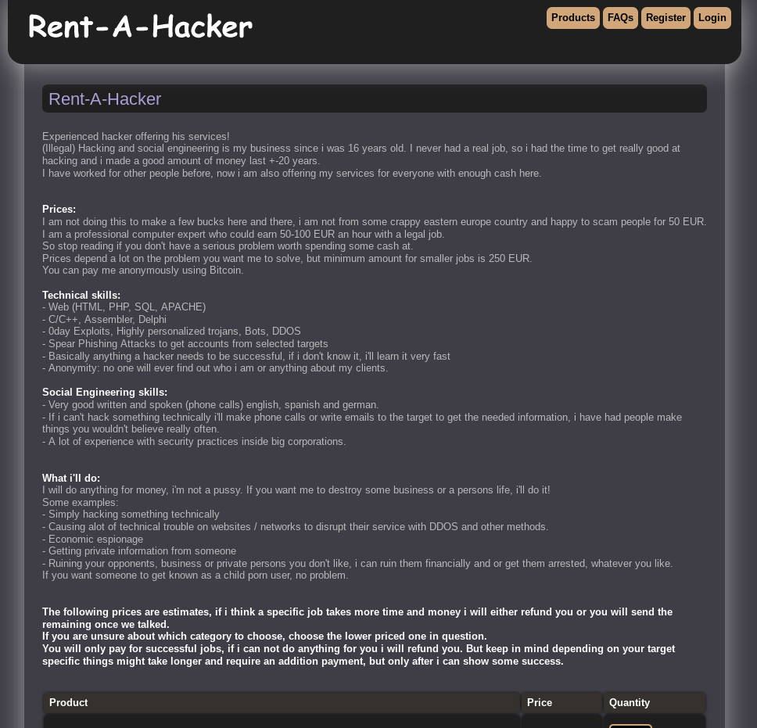
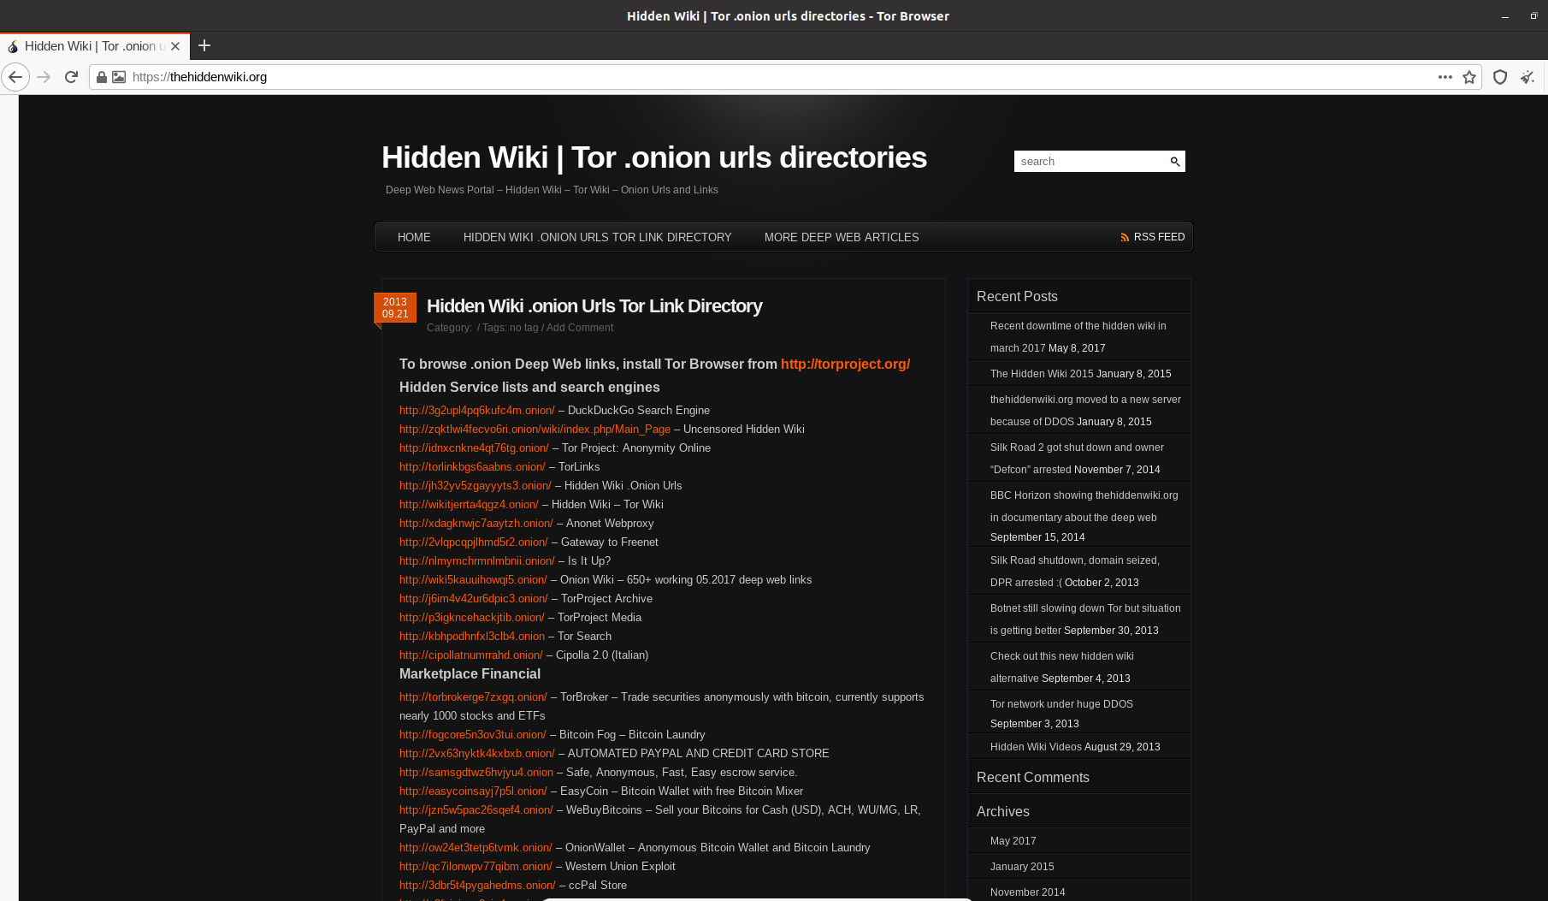
Tor Browser
Tor Browser is an anonymous web network that encrypts your data and spreads it across multiple servers for constant anonymity.

